Slide 1












Online wardrobe app ELITE THREADS
JAVA PROJECT
ANGELINE A
2348409

Slide 2
TABLE OF CONTENTS
INTRODUCTION
Implementation
01
02
PACKAGES, FILES AND THEIR CONNECTION
IMPLEMENTATION OF JAVA CONCEPTS
WORKING
REFERENCES
03
04
APPLICATION FEATURES, WORKING OF THE CODE AND OUTPUT
MATERIALAS

Slide 3


INTRODUCTION
01
PACKAGES, FILES AND THEIR CONNECTION

Slide 4


Packages (files)
User
Item
Product
Category
Admin
AccountManagement
Customer
KidsCategory
KidsItemType
MenItemType
11. WomenItemType
12. WomenWardrobe
13. MenWardrobe
14. KidsWardrobe
15. WomenWardrobe
16. ShoppingCart
17. ShoppingApp

Slide 5
CONNECTIONS
USER
Product
Admin
Customer
Main
ShoppingApp
ShoppingCart
Customer
CATEGORY
ShoppingApp
Main
ShoppingApp

Slide 6
CONNECTIONS
Accountmanagement
KIDSCATEGORY
Admin
ShoppingApp
ShoppingApp
KidsWardrobe
KidsItem
Kidswardrobe
KidsWardrobe
ShoppingApp

Slide 7
CONNECTIONS
MenItemtype
menwardrobe
MenWardrobe
ShoppingApp
WomenItemtype
womenwardrobe
WomenWardrobe
ShoppingApp

Slide 8
CONNECTIONS
ShoppingApp
shoppingcart
Main
ShoppingApp
ShoppingCart
MenWardrobe
KidsWardrobe
WomenWardrobe
Item
ShoppingApp
ShoppingCart
MenWardrobe
KidsWardrobe
WomenWardrobe

Slide 9
IMPLEMENTATION
02
IMPLEMENTATION OF JAVA CONCEPTS

Slide 10

ENCAPSULATION
Explanation: Encapsulation is the concept of bundling data (attributes) and methods (behavior) that operate on the data into a single unit called a class. It hides the internal state of an object from the outside world and only exposes the necessary functionality through methods.
Working in the Application: In the shopping application, various classes such as Item, Category, User, etc., encapsulate their attributes (like name, price, username, etc.) and methods (like adding items to the cart, calculating total amount, etc.). This ensures data integrity and reduces the risk of unintended access or modification.

Slide 11
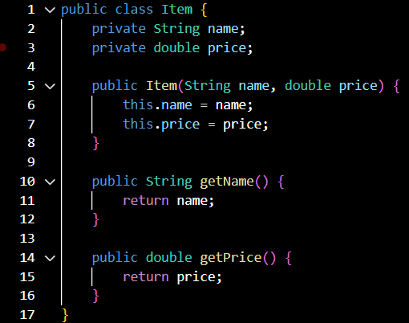

Slide 12
Inheritance
Explanation: Inheritance is a mechanism in which a new class (subclass) is derived from an existing class (superclass). The subclass inherits the attributes and methods of the superclass and can also have its own unique attributes and methods.
Working in the Application: The application uses inheritance to create different types of wardrobes for men, women, and kids. For example, MenWardrobe and WomenWardrobe inherit from a common superclass Wardrobe, which contains common methods for browsing items. This promotes code reuse and helps in maintaining a consistent structure across different wardrobe types.

Slide 13
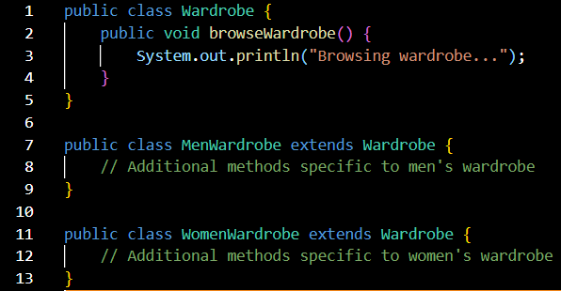

Slide 14
PolYMORPHISM
Explanation: Polymorphism allows objects of different classes to be treated as objects of a common superclass. It enables methods to behave differently based on the object they are called on, leading to flexibility and extensibility in the code.
Working in the Application: Polymorphism is demonstrated when different categories of items (men's clothing, women's clothing, etc.) are added to the shopping cart using a common method addToCart() from the ShoppingCart class. The specific behavior of adding an item is determined at runtime based on the type of item being added.

Slide 15
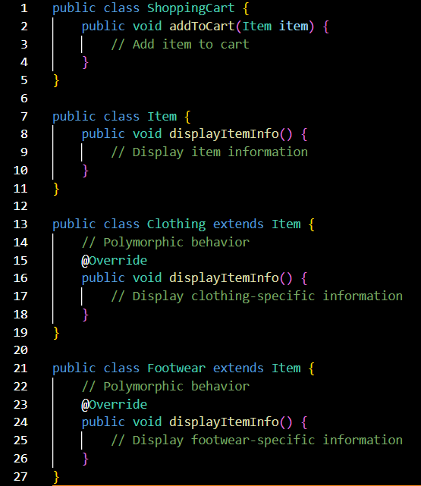

Slide 16
abstraction
Explanation: Abstraction involves hiding complex implementation details and exposing only the essential features of an object. It allows programmers to focus on what an object does rather than how it does it.
Working in the Application: The application abstracts away the internal implementation of shopping cart operations, such as adding items, calculating total amounts, and generating invoices. Users interact with high-level methods and interfaces without needing to understand the underlying complexities.

Slide 17
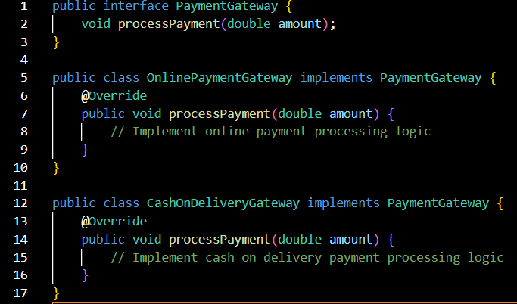

Slide 18
interface
Explanation: Interfaces define a contract for classes to implement, specifying a set of methods that must be implemented by any class that implements the interface. This promotes loose coupling and allows classes to work with objects of different types through a common interface.
Working in the Application: Interfaces like AccountManagement define methods for user authentication (signUp() and login()). Various classes such as ShoppingApp implement this interface, providing their own implementations of these methods. This allows for flexibility in authentication mechanisms and promotes code modularization.

Slide 19
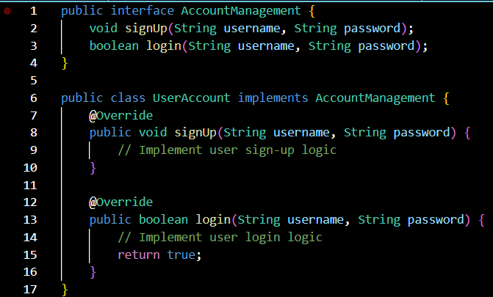

Slide 20
modularity
Explanation: Modularity is the division of a software system into separate, independently replaceable modules. It promotes code organization, reusability, and easier maintenance by breaking down complex systems into smaller, manageable components.
Working in the Application: The application is divided into modular components such as wardrobes for different categories, shopping cart functionalities, user authentication, and payment processing. Each module encapsulates related functionality, making it easier to understand, modify, and extend the system.

Slide 21
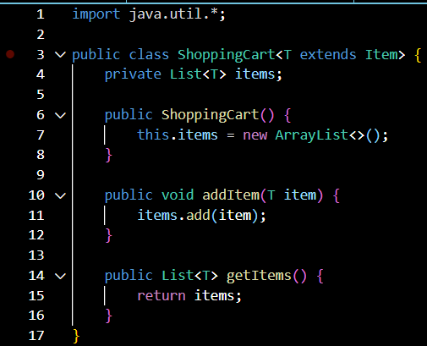
GENERICS

Slide 22
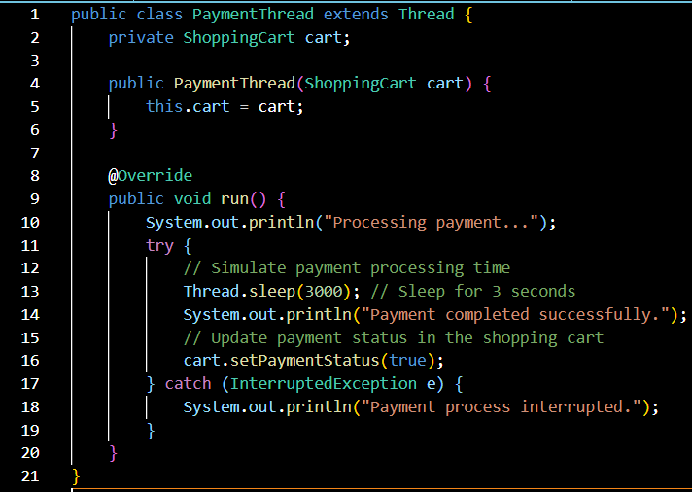
MULTITHREADING

Slide 23
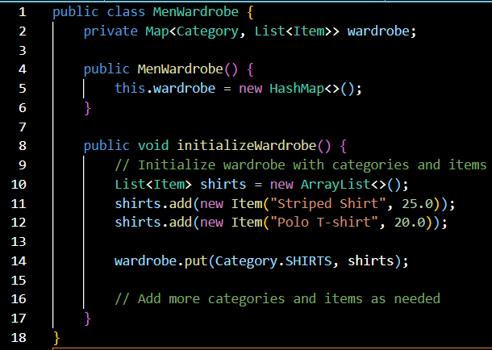
COLLECTION

Slide 24
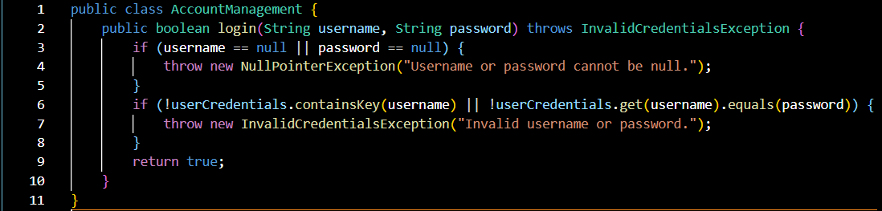
EXCEPTIONAL HANDLING

Slide 25
WORKING
03
APPLICATION FEATURES, WORKING OF THE CODE AND OUTPUT

Slide 26
APPLICATION FEATURES
User Authentication and Signup
Browsing Product Categories
Adding Items to the Cart
Finalizing Purchase
Optional Premium Membership Upgrade
Invoice and delivery Tracking

Slide 27
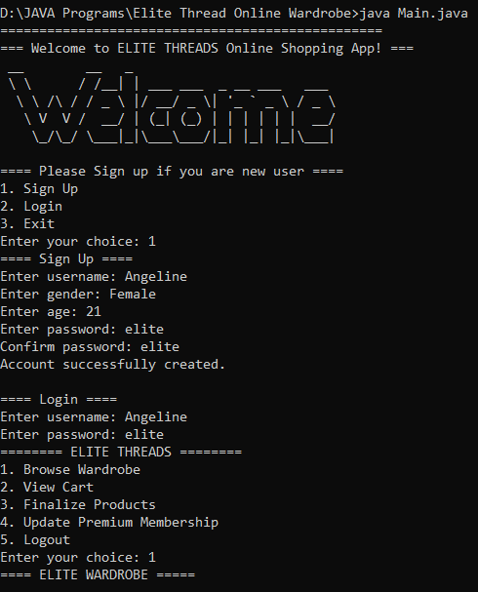
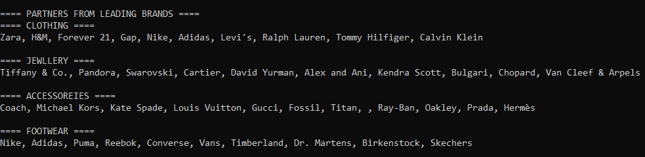
OUTPUT

Slide 28
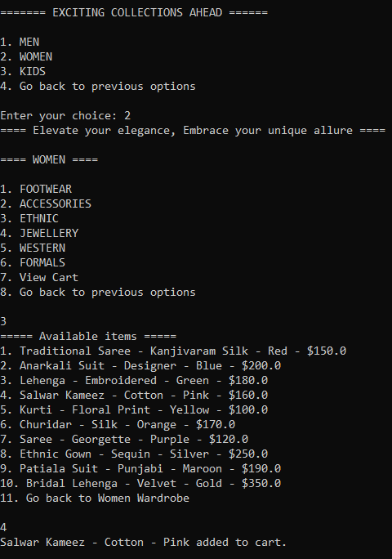
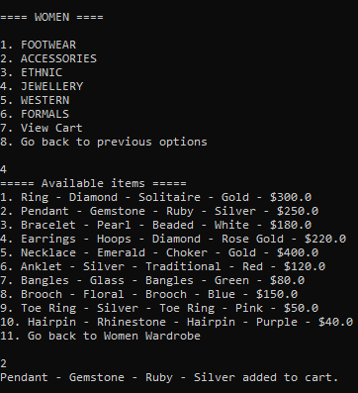
OUTPUT

Slide 29
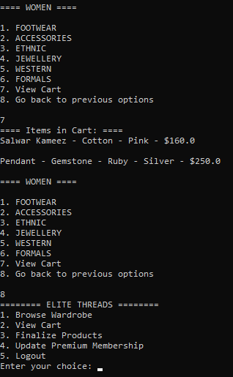
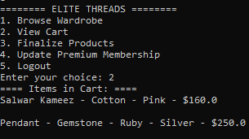
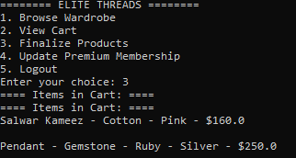
OUTPUT

Slide 30
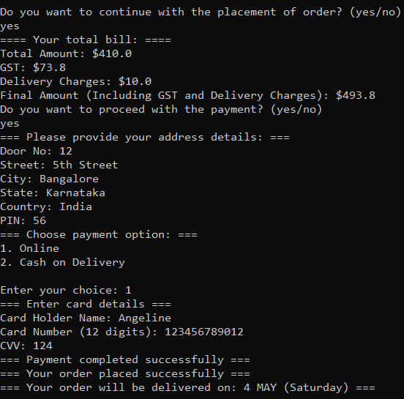
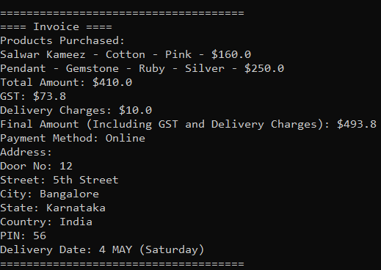
OUTPUT

Slide 31
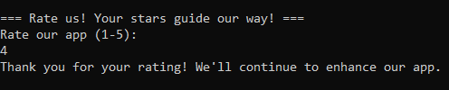
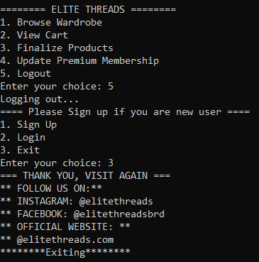
OUTPUT

Slide 32
references
04

Slide 33
References
[1] Book- https://github.com/EbookFoundation/free-programming-books/blob/main/books/free-programming-books-langs.md
[2] GitHub link - https://devfreebooks.github.io/java/
[3] Generics - https://www.tutorialspoint.com/java/java_generics.htm
[4] Great Learning - https://www.mygreatlearning.com/blog/oops-concepts-in-java/
[5] Oracle Java Documentation - https://docs.oracle.com/en/java/
[6] Java Tutorials - https://docs.oracle.com/javase/tutorial/

Slide 34
THANK you!

